Slide 1
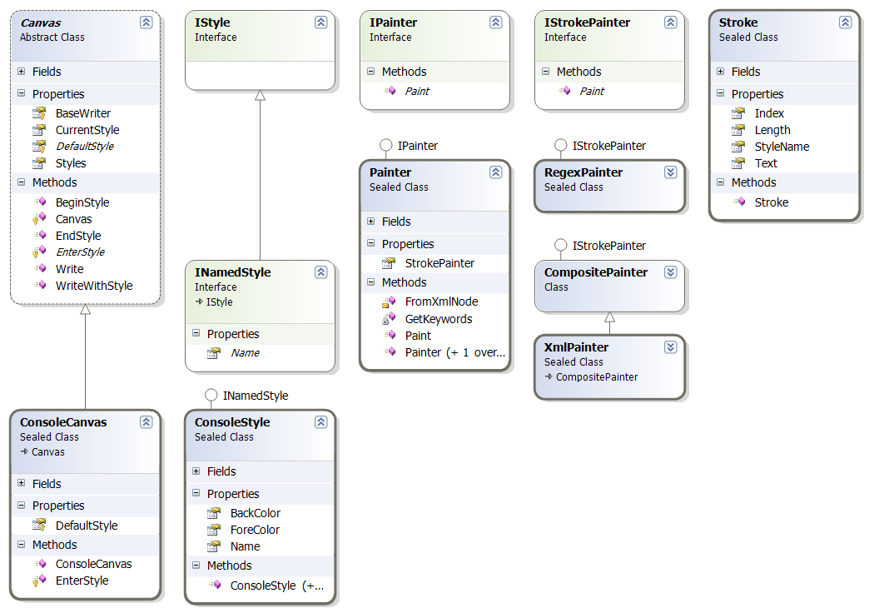
2.5 OOP Principles Part 1
academy.zariba.com

Slide 2
Lecture Content
Fundamental Principles of OOP
Inheritance
Abstraction
Encapsulation

Slide 3
1. Fundamental Principles of OOP
Inheritance
Inherit members from parent class
Abstraction
Define and execute abstract actions
Encapsulation
Hide the internals of a class
Polymorphism
Access a class through its parent interface

Slide 4
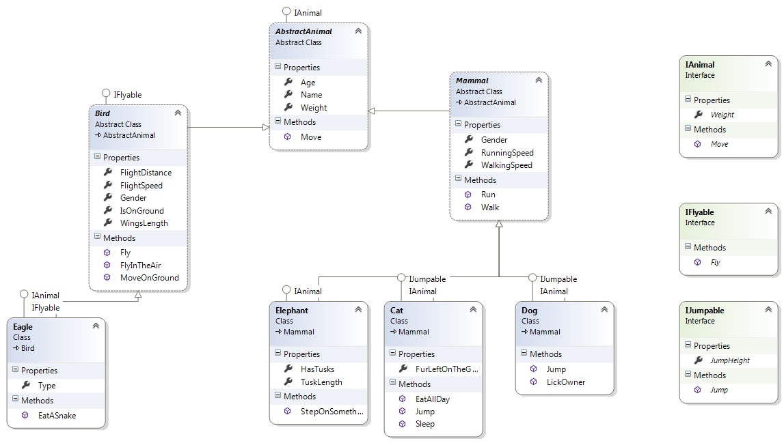

2. Inheritance

Slide 5
Inheritance
Inheritance allows child (derived) classes to inherit the characteristics of an existing parent (base) class – attributes and operations
Derived classes can extend the parent class by adding new fields or methods and redefining already existing methods
Use inheritance for building is-a relationship
Use property implementation when building has-a relationship.

Slide 6
Inheritance - Benefits
Extensibility
Reusability
Provides abstraction
Eliminates redundant code

Slide 7
Inheritance – Important Aspects
Structures cannot be inherited
In C# there is no multiple inheritance
Multiple inheritance can be implemented with interfaces
Constructors are not inherited
Inheritance is a transitive relation
You cannot remove inherited features
A class can declare virtual methods and properties

Slide 8

3. Abstraction

Slide 9
Abstraction
Abstraction means ignoring irrelevant features, properties, or functions and emphasizing on the ones relevant to the specific project
Abstraction helps managing complexity
Abstraction in .Net can be done with the use of abstract classes or interfaces (or both)

Slide 10
Interfaces
Interfaces define a set of operations and attributes
They do not provide any implementation – only a contract for implementing the defined features of a class
Can be extended by other interfaces
Cannot be instantiated

Slide 11
Abstract Classes
Abstract classes are a mix between an interface and a class
Partially or fully provide implementation
Non implemented methods are declared as abstract and are left empty (same as interfaces)
Cannot be instantiated
Child classes, which are not abstract, should implement all abstract methods

Slide 12

4. Encapsulation
Fields are always declared private
Constructors are almost always public
Interface methods are always public
Non-interface methods are declared private or
protected
Hides implementation details and reduces
complexity

Slide 13
Homework
1. We are given a school. In the school there are classes of students. Each class has a set of teachers. Each teacher teaches a set of disciplines. Students have a name and a unique class number. Classes have unique text identifier. Teachers have a name. Disciplines have a name, number of lectures and number of exercises. Both teachers and students are people. Students, classes, teachers and disciplines could have optional comments (free text block). Your task is to identify the OOP classes, their attributes and operations, encapsulate their fields , define the class hierarchy and create a class diagram.

Slide 14
Homework
2. Define an abstract class Human with a first name and last name. Define a new class Student which is derived from Human and a has a new field – grade. Define class worker derived from Human with a new property WeekSalary and WorkHoursPerDay and a method MoneyPerHour() which returns the money earned per hour. Define the constructors and properties for this hierarchy. Initialize a list of 10 students and sort them by grade in ascending order (Linq?). Initialize a list of 10 workers and sort them by money per hour in descending order. Merge the lists and sort them by first name and last name

Slide 15

References

Slide 16



Zariba Academy
Questions

